Slide 1

Graph Algorithms 11.1 – 11.5
CMPT 225

Slide 2


High-five Puzzle
At a party, some people high-five each other (no one high-fives themselves). Each of them tells you how many people they high-fived. You don’t remember what each person said, but you do remember that the sum of all the reported high-fives was 10.
How many people were at the party?
How many high-fives occurred?

Slide 3
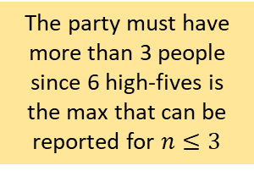
High-five Puzzle
1
n=1
At a party, some people high-five each other (no one high-fives themselves). Each of them tells you how many people they high-fived. You don’t remember what each person said, but you do remember that the sum of all the reported high-fives was 10.
How many people were at the party?
How many high-fives occurred?
1
2
n=2
The party must have more than 3 people since 6 high-fives is the max that can be reported for $n≤3$
1
2
n=3
3

Slide 4
High-five Puzzle
1
2
n=4
? high-fives
At a party, some people high-five each other (no one high-fives themselves). Each of them tells you how many people they high-fived. You don’t remember what each person said, but you do remember that the sum of all the reported high-fives was 10.
How many people were at the party?
How many high-fives occurred?
3
4
1
2
n=5
? high-fives
5
3
4

Slide 5
High-five Puzzle
1
2
n=4
10 high-fives
At a party, some people high-five each other (no one high-fives themselves). Each of them tells you how many people they high-fived. You don’t remember what each person said, but you do remember that the sum of all the reported high-fives was 10.
How many people were at the party?
How many high-fives occurred?
3
4
1
2
n=5
10 high-fives
5
3
4

Slide 6
High-five Puzzle
n=5
Not everyone needs to be involved in a high five; the problem says some people high five each other
1
2
1
2
5
5
3
4
3
4
5 people can high five in various ways such that the total sum of all ends of an edge going into a vertex is 10
1
2
3
4
5

Slide 7
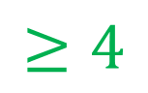
High-five Puzzle
1
2
n=4
At a party, some people high-five each other (no one high-fives themselves). Each of them tells you how many people they high-fived. You don’t remember what each person said, but you do remember that the sum of all the reported high-fives was 10.
How many people were at the party?
How many high-fives occurred?
3
4
As long as there are 4 or more people, we can draw 5 edges, where the sum of all the ends of the edges is 10.
$$≥4$$
n=5
1
2
5
3
4

Slide 8
High-five Puzzle
1
2
n=4
At a party, some people high-five each other (no one high-fives themselves). Each of them tells you how many people they high-fived. You don’t remember what each person said, but you do remember that the sum of all the reported high-fives was 10.
How many people were at the party?
How many high-fives occurred?
3
4
$$≥4$$
n=5
1
2
exactly 5
5
3
4

Slide 9
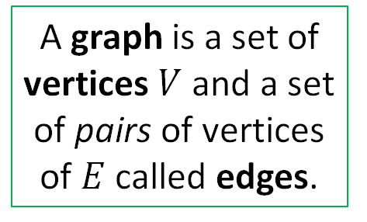
Basic Definitions
a
b
A graph is a set of vertices $V$ and a set of pairs of vertices of $E$ called edges.
c
e
d
V =
E =

Slide 10

Basic Definitions
a
b
A graph is a set of vertices $V$ and a set of pairs of vertices of $E$ called edges.
c
e
d
V = {a, b, c, d, e}
E = {ac, ad, cd, ec}

Slide 11
Basic Definitions
a
b
A graph is a set of vertices $V$ and a set of pairs of vertices of $E$ called edges.
This is an undirected graph, E.g. ec and ce are the same edge
c
e
d
V = {a, b, c, d, e}
E = {ac, ad, cd, ec}

Slide 12
Basic Definitions
a
Directed graphs are called digraphs for short.
b
A graph is a set of vertices $V$ and a set of pairs of vertices of $E$ called edges.
This is a directed graph, since the edges are directed.
c
e
The edges are directed.
E.g. ec and ce are different edges.
d
V = {a, b, c, d, e}
E =

Slide 13
Basic Definitions
a
Directed graphs are called digraphs for short.
b
A graph is a set of vertices $V$ and a set of pairs of vertices of $E$ called edges.
This is a directed graph, since the edges are directed.
c
e
The edges are directed.
E.g. ec and ce are different edges.
d
V = {a, b, c, d, e}
E = {ac, ce, dc, da, ec }

Slide 14
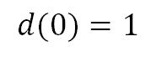
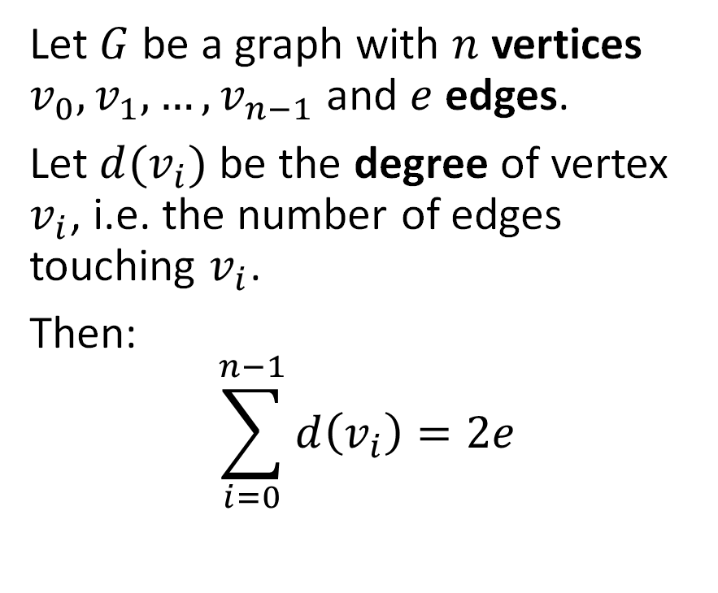
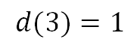
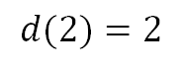
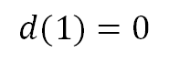
Handshaking Lemma
0
$$d(0)=1$$
Let $G$ be a graph with $n$ vertices $v_{0}, v_{1}, …, v_{n−1}$ and $e$ edges.
Let $d(v_{i})$ be the degree of vertex $v_{i}$, i.e. the number of edges touching $v_{i}$.
Then:
$$\sum_{i=0}^{n−1}{d\left(v_{i}\right)=2e}$$
$$d(1)=0$$
1
$$d(2)=2$$
2
$$d(3)=1$$
3
Justification: every edge contributes 2 to the degree count.
The sum of the degrees of the vertices of a graph is twice the number of its edges.

Slide 15
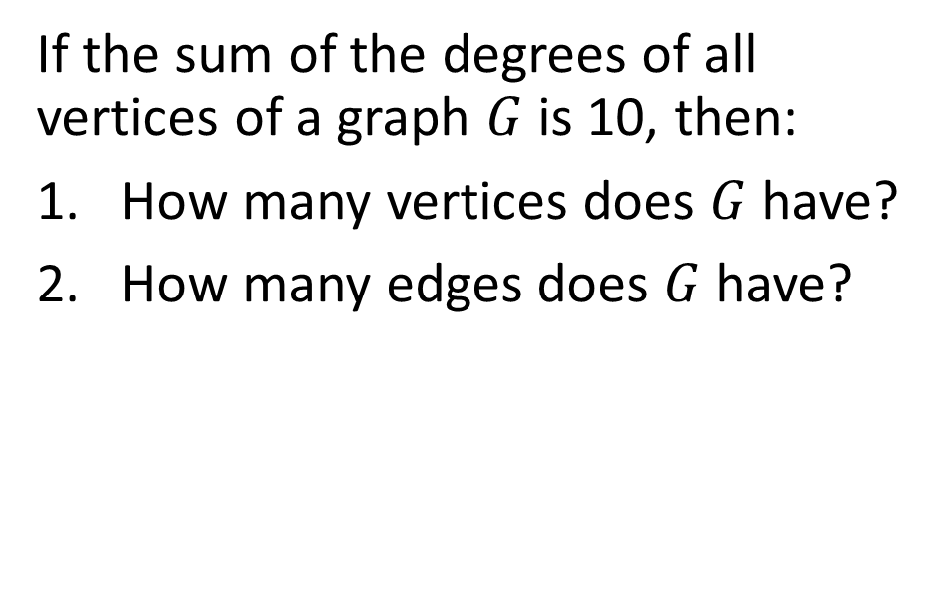
High-five Puzzle
At a party, some people high-five each other (no one high-fives themselves). Each of them tells you how many people they high-fived. You don’t remember what each person said, but you do remember that the sum of all the reported high-fives was 10.
How many people were at the party?
How many high-fives occurred?
If the sum of the degrees of all vertices of a graph $G$ is 10, then:
How many vertices does $G$ have?
How many edges does $G$ have?

Slide 16
Basic Definitions
A graph is a set of vertices $V$ and a set of pairs of vertices of $E$ called edges.
Depending on the application, a graph might have:
A self-loop an edge connected to the same vertex
More than one edge between vertices:
a
A graph with no self-loops and at most one edge between each vertex pair is called a simple graph.
e
c

Slide 17
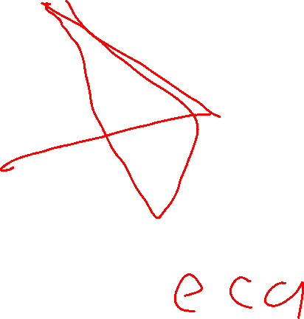
Basic Definitions
a
b
A graph is a set of vertices $V$ and a set of pairs of vertices of $E$ called edges.
A path is an alternating sequence of vertices and edges, starting and ending with a vertex, such that each edge is connected to the vertex before and after it.
c
e
d
Write 3 paths from e to d.

Slide 18
Basic Definitions
a
b
A graph is a set of vertices $V$ and a set of pairs of vertices of $E$ called edges.
A path is an alternating sequence of vertices and edges, starting and ending with a vertex, such that each edge is connected to the vertex before and after it.
c
e
d
Write 3 paths from e to d.
A simple path has no repeated vertices.
Path 1: ecad Path 2: ecd Path 3: ecdacdacd

Slide 19
Basic Definitions
a
b
A graph is a set of vertices $V$ and a set of pairs of vertices of $E$ called edges.
A cycle is a path where there are at least two different ways to get to the different vertices on the path.
c
e
d
A path is an alternating sequence of vertices and edges, starting and ending with a vertex, such that each edge is connected to the vertex before and after it.
Which of these paths is a cycle?
Path 1: ecad Path 2: ecd Path 3: dac
A simple path has no repeated vertices.

Slide 20
Basic Definitions
a
b
A graph is a set of vertices $V$ and a set of pairs of vertices of $E$ called edges.
A cycle is a path with a loop between 2 or more vertices.
c
e
d
A path is an alternating sequence of vertices and edges, starting and ending with a vertex, such that each edge is connected to the vertex before and after it.
Which of these paths is a cycle?
Path 1: ecad Path 2: ecd Path 3: dac
This is a cycle.
A simple path has no repeated vertices.

Slide 21
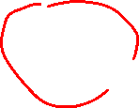
Basic Definitions
a
b
A graph is a set of vertices $V$ and a set of pairs of vertices of $E$ called edges.
A graph is connected if for any two vertices there is a path between them.
c
e
d
Is this graph connected?

Slide 22
Basic Definitions
a
b
A graph is a set of vertices $V$ and a set of pairs of vertices of $E$ called edges.
A graph is connected if for any two vertices there is a path between them.
c
e
d
Is this graph connected?
No
How many different ways can you make the graph connected by adding one edge?

Slide 23
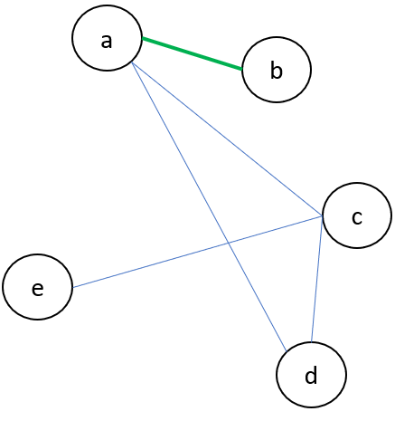
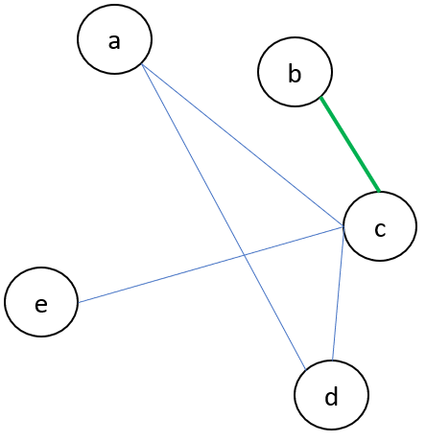
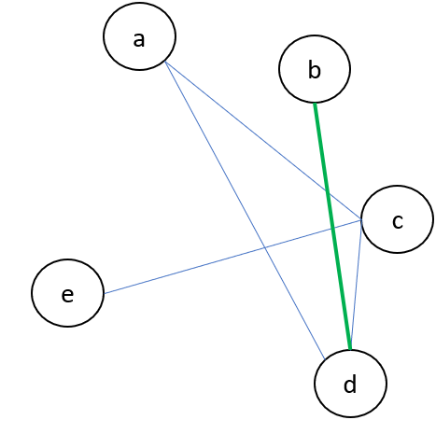
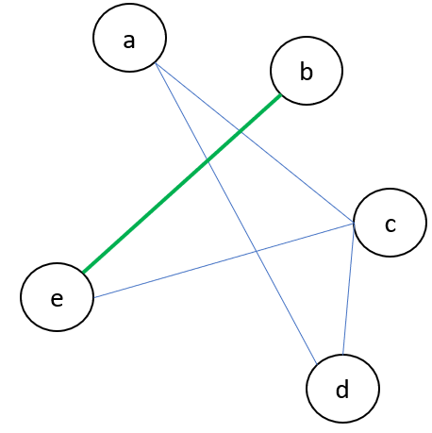
Basic Definitions
a
b
A graph is a set of vertices $V$ and a set of pairs of vertices of $E$ called edges.
A graph is connected if for any two vertices there is a path between them.
c
e
d
Is this graph connected?
No
How many different ways can you make the graph connected by adding one edge?
4 ways connect b to any of the other nodes

Slide 24
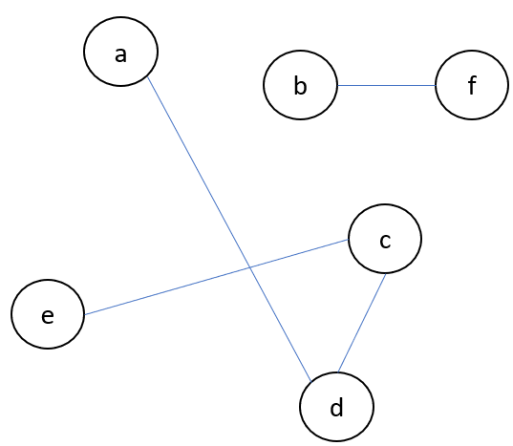
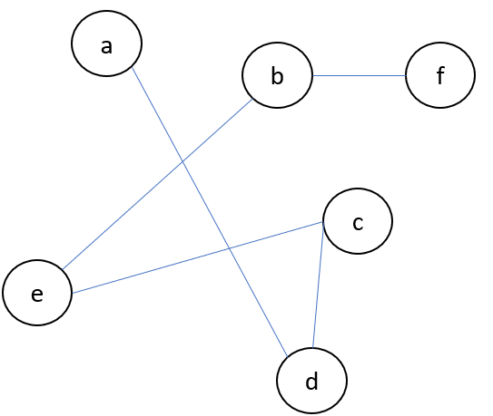
Basic Definitions
A forest is a graph with no cycles.
A graph is a set of vertices $V$ and a set of pairs of vertices of $E$ called edges.
A graph is connected if for any two vertices there is a path between them.
A tree is a connected forest.
Note that this is quite different than the data structure definition of a tree we have earlier in the course!

Slide 25

Basic Definitions
A forest is a graph with no cycles.
A graph is a set of vertices $V$ and a set of pairs of vertices of $E$ called edges.
A tree is a connected forest.
A tree T is a set of nodes, storing values, in a parent-child relationship with the following properties:
T could be empty, i.e. it has no nodes. This is called the empty tree.
If T is non-empty, it has a special node called the root of T that has no parent.
Each node v of T different from the root has a unique parent node w. We say v is a child of w, and w is the parent of v.
A graph is connected if for any two vertices there is a path between them.
The data structure definition of a tree given earlier in the course is quite different than the graph theory definition!
The data structure definition is meant to be useful for implementing trees in a program, while the graph theory definition is for mathematics.

Slide 26
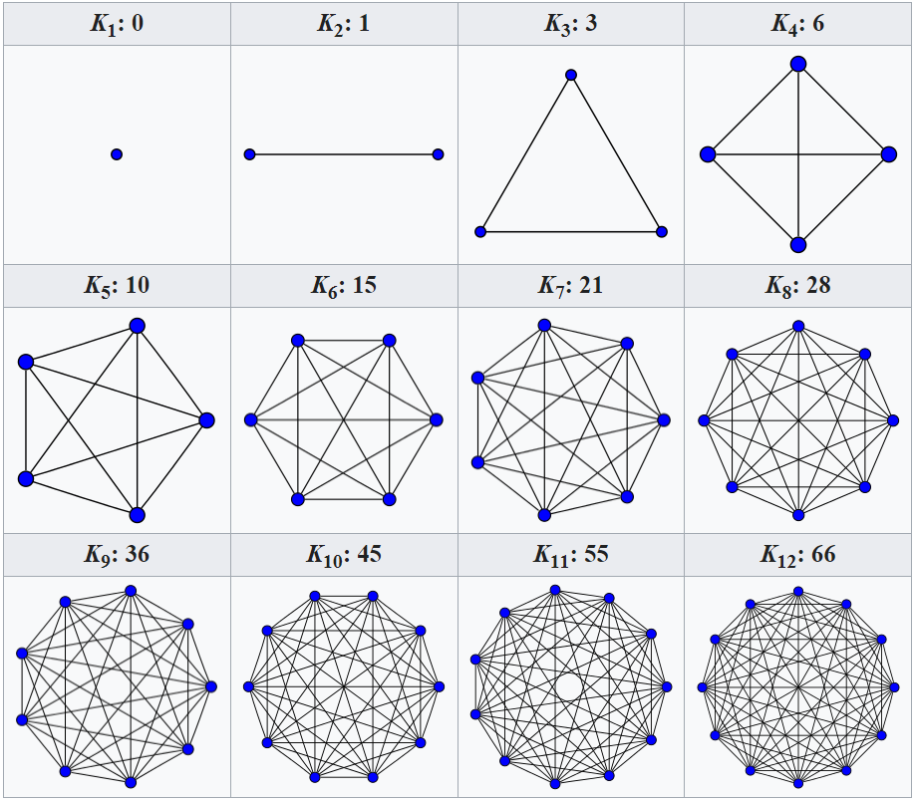
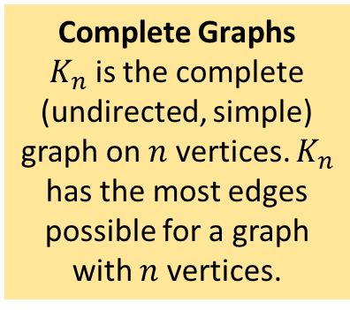
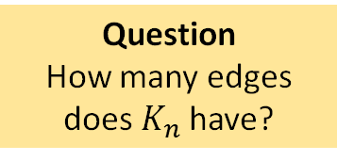
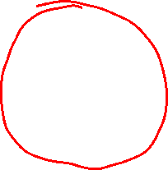
Some Special Graphs
Complete Graphs $K_{n}$ is the complete (undirected, simple) graph on $n$ vertices. $K_{n}$ has the most edges possible for a graph with $n$ vertices.
Question
How many edges does $K_{n}$have?
Diagram from the Wikipedia article on complete graphs.

Slide 27
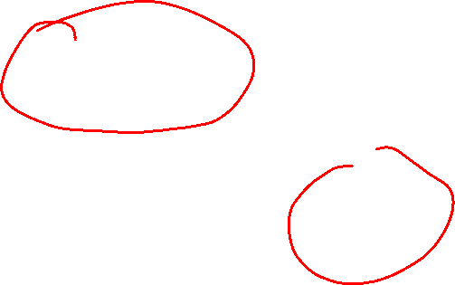
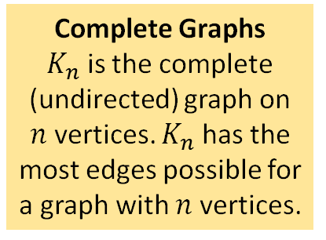
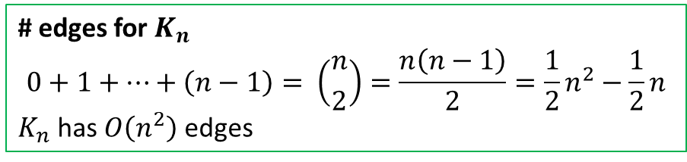
Some Special Graphs
Complete Graphs $K_{n}$ is the complete (undirected) graph on $n$ vertices. $K_{n}$ has the most edges possible for a graph with $n$ vertices.
Question
How many edges does $K_{n}$have?
# edges for $K_{n}$
$$0+1+…+\left(n−1\right)= \left({n \atop 2}\right)=\frac{n\left(n−1\right)}{2}=\frac{1}{2}n^{2}−\frac{1}{2}n$$
$K_{n}$ has $O\left(n^{2}\right)$ edges
Diagram from the Wikipedia article on complete graphs.

Slide 28
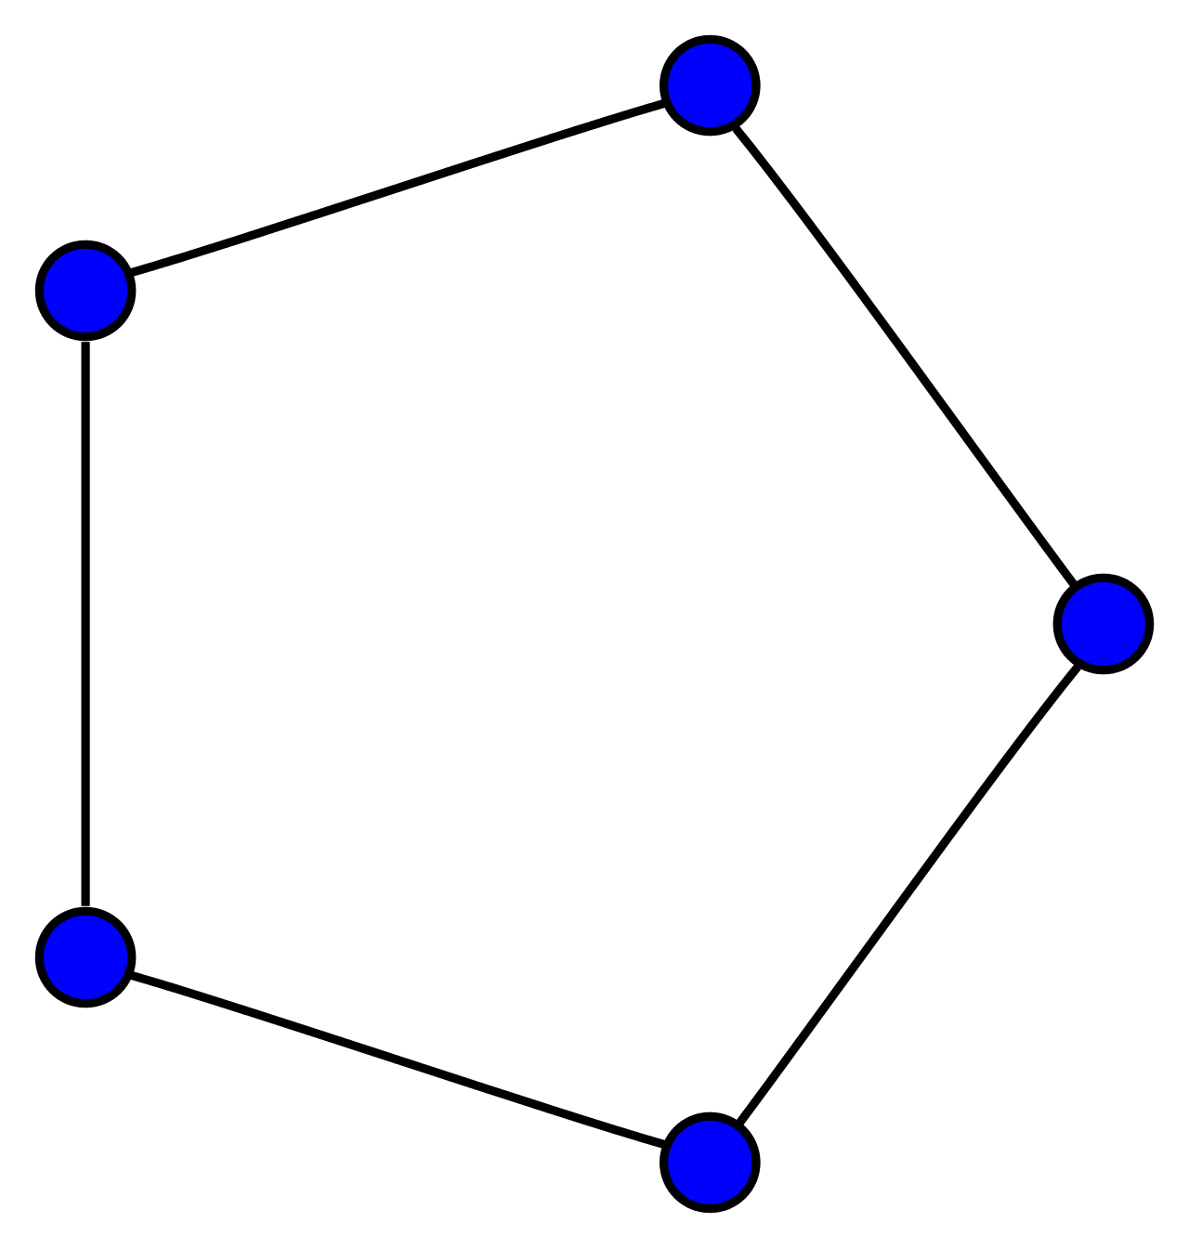
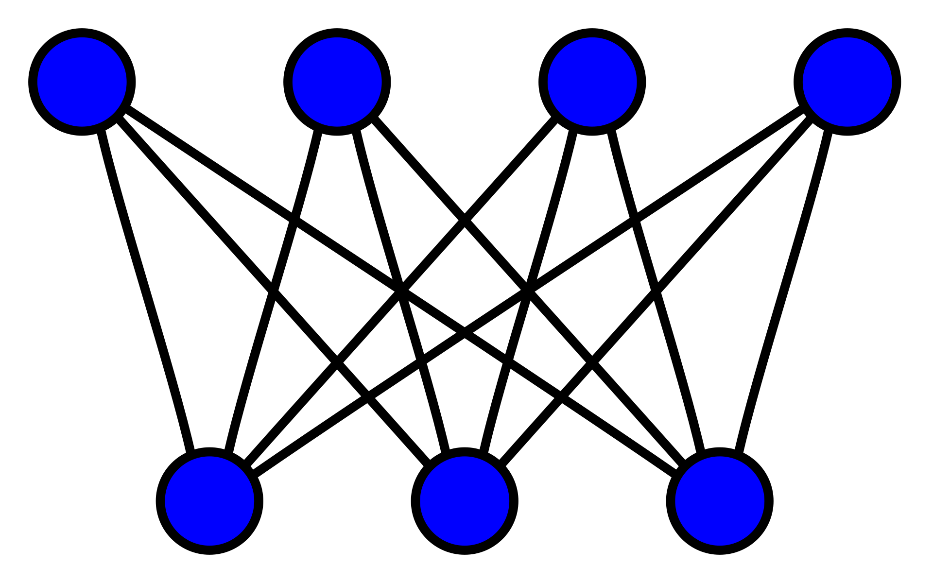
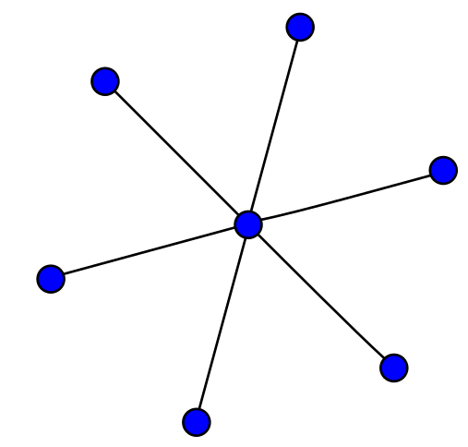
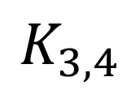
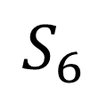
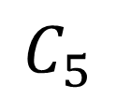
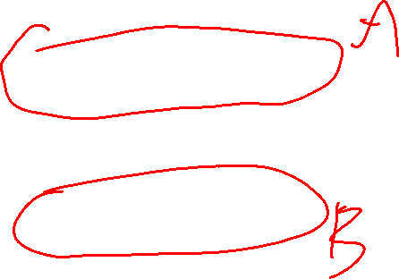
Some Special Graphs
$$K_{3,4}$$
$$C_{5}$$
$$S_{6}$$
Bipartite graph Vertices are divided into two disjoint sets, and each edge has an end in both sets.
Cycle graph A graph with a single cycle.
Star graph A graph with one internal node and all the rest are leaf nodes.
Trees are bipartite!

Slide 29
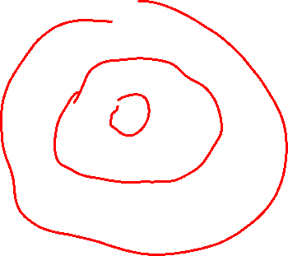
Some Special Graphs
Question Are all star graphs bipartite?
$$K_{3,4}$$
$$C_{5}$$
$$S_{6}$$
Bipartite graph Vertices are divided into two disjoint sets, and each edge has an end in both sets.
Cycle graph A graph with a single cycle.
Star graph A graph with one internal node and all the rest are leaf nodes.
Trees are bipartite!

Slide 30
Some Special Graphs
Question Are all star graphs bipartite?
Yes! The center vertex is in one set, and the vertices are in the other.
$$K_{3,4}$$
$$C_{5}$$
$$S_{6}$$
Bipartite graph Vertices are divided into two disjoint sets, and each edge has an end in both sets.
Cycle graph A graph with a single cycle.
Star graph A graph with one internal node and all the rest are leaf nodes.
Trees are bipartite!

Slide 31
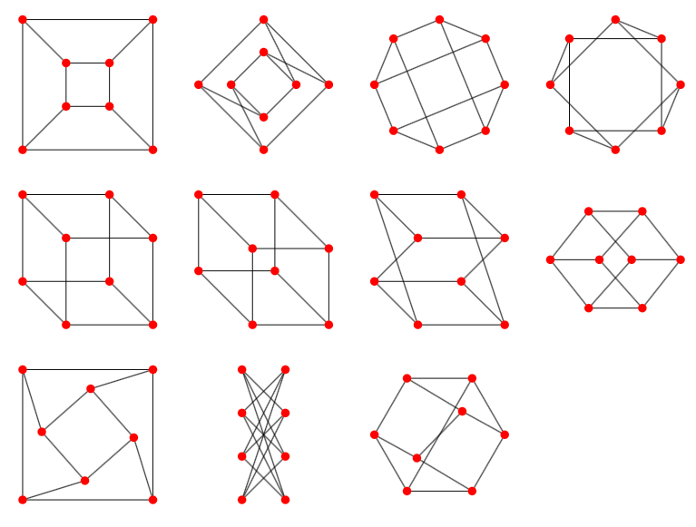
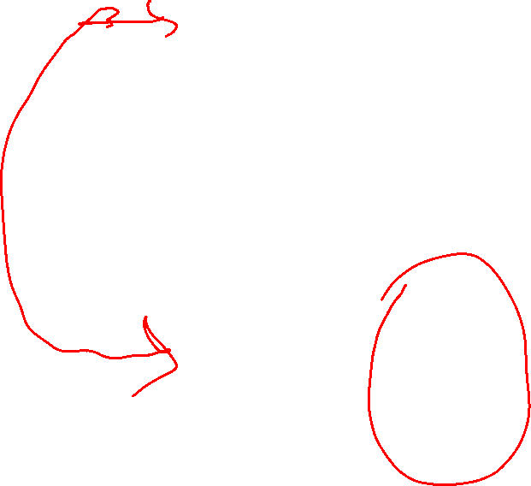
The Cube
11 different ways of drawing the same graph
Different ways of drawing a graph might give you different insights into it.
vertices are the corners of a cube
It’s bipartite

Slide 32
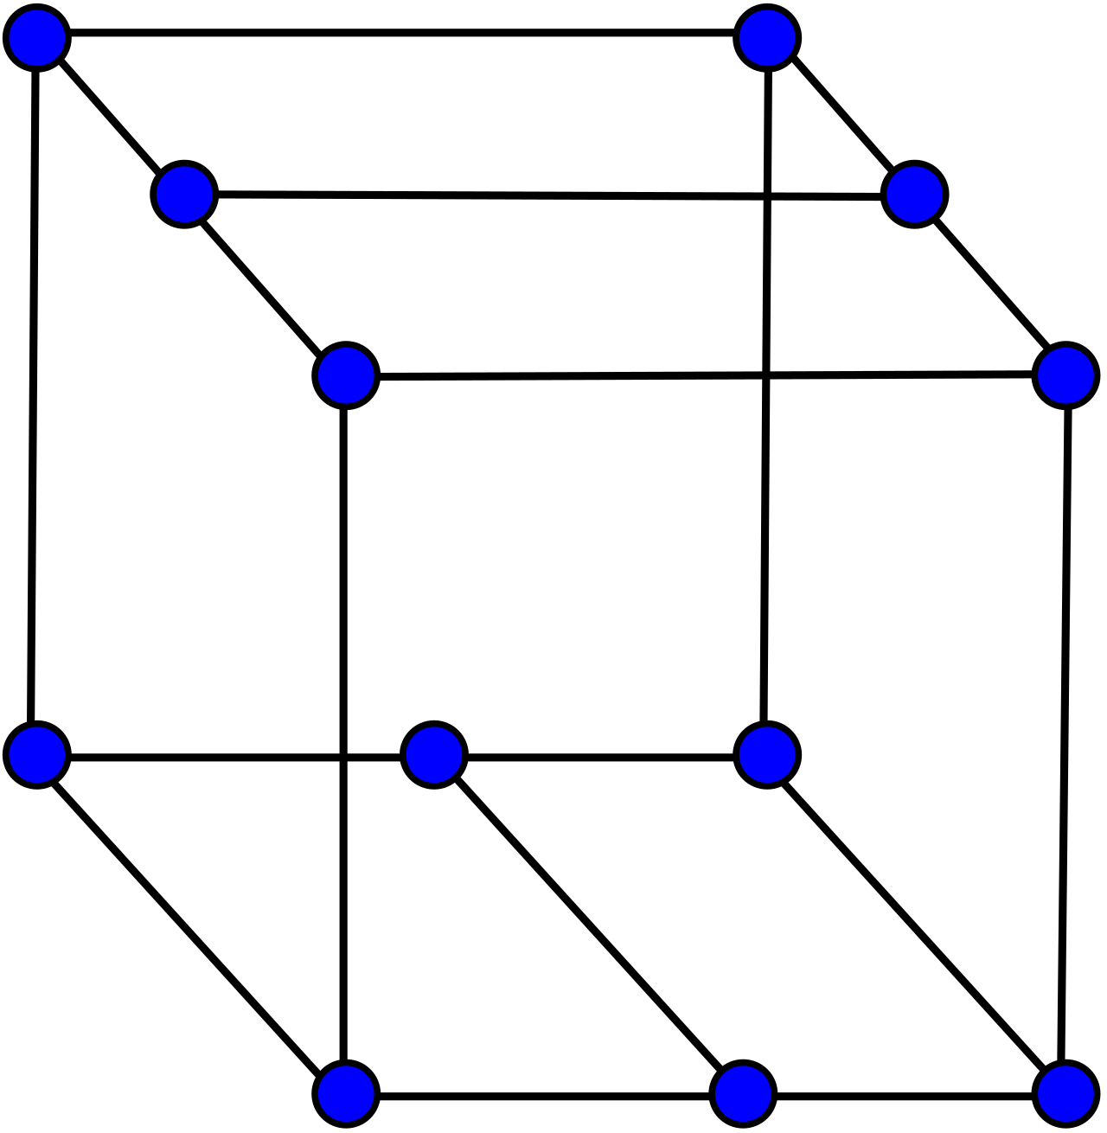
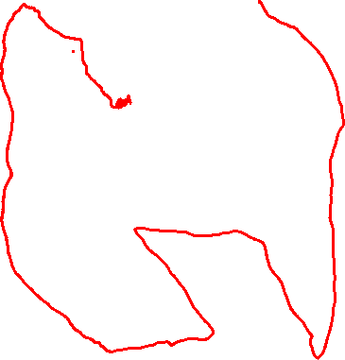
The Bidiakis Cube
A Hamiltonian path is a path that visits all vertices exactly once. Determining whether a graph has one is NP-complete.
All vertices have degree 3, so this is called a 3-regular graph, or cubic graph. It’s also has a Hamiltonian path.
These two graphs are the same, they are just layed-out differently.
Question: Can you draw a Hamiltonian path on the graph?
See Wikipedia’s list of graphs for more examples.

Slide 33
The Bidiakis Cube
A Hamiltonian path is a path that visits all vertices exactly once. Determining whether a graph has one is NP-complete.
All vertices have degree 3, so this is called a 3-regular graph, or cubic graph. It’s also has a Hamiltonian path.
These two graphs are the same, they are just layed-out differently.
Question: Can you draw a Hamiltonian path on the graph?
See Wikipedia’s list of graphs for more examples.

Slide 34
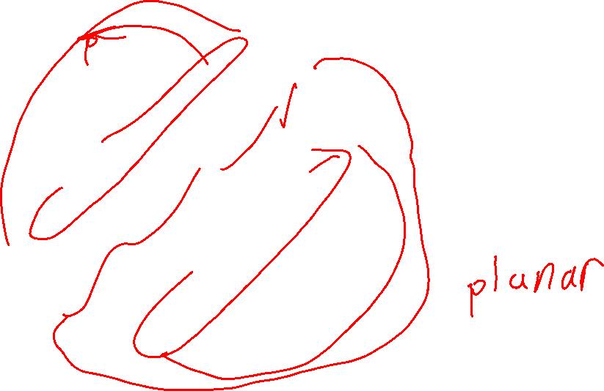
The Bidiakis Cube
A Hamiltonian path is a path that visits all vertices exactly once. Determining whether a graph has one is NP-complete.
All vertices have degree 3, so this is called a 3-regular graph, or cubic graph. It’s also has a Hamiltonian path.
These two graphs are the same, they are just layed-out differently.
Question: Can you draw the graph on a piece of paper so that no edges cross?
See Wikipedia’s list of graphs for more examples.

Slide 35
The Bidiakis Cube
Question: Can you draw the graph on paper so that no edges cross?
Yes!
See Wikipedia’s list of graphs for more examples.

Slide 36
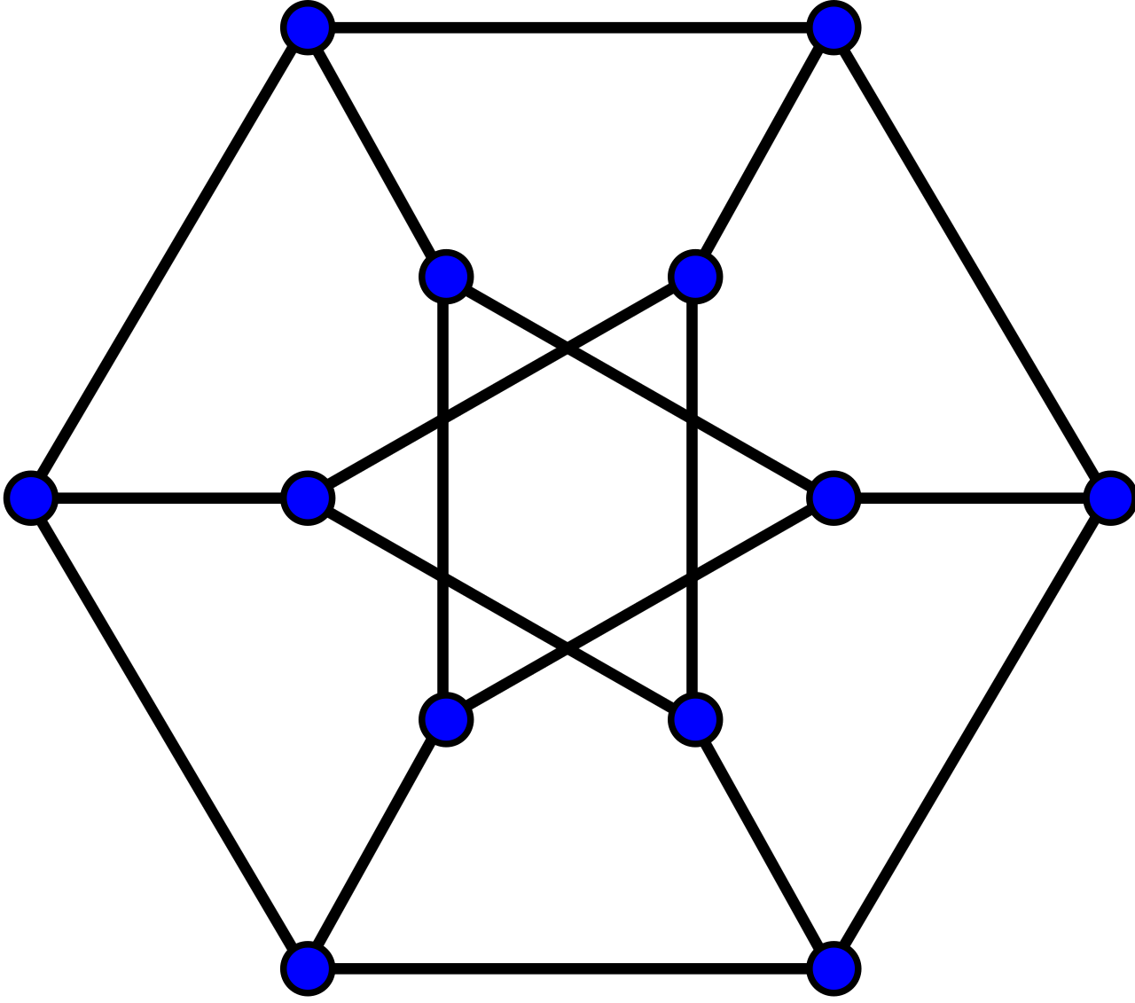
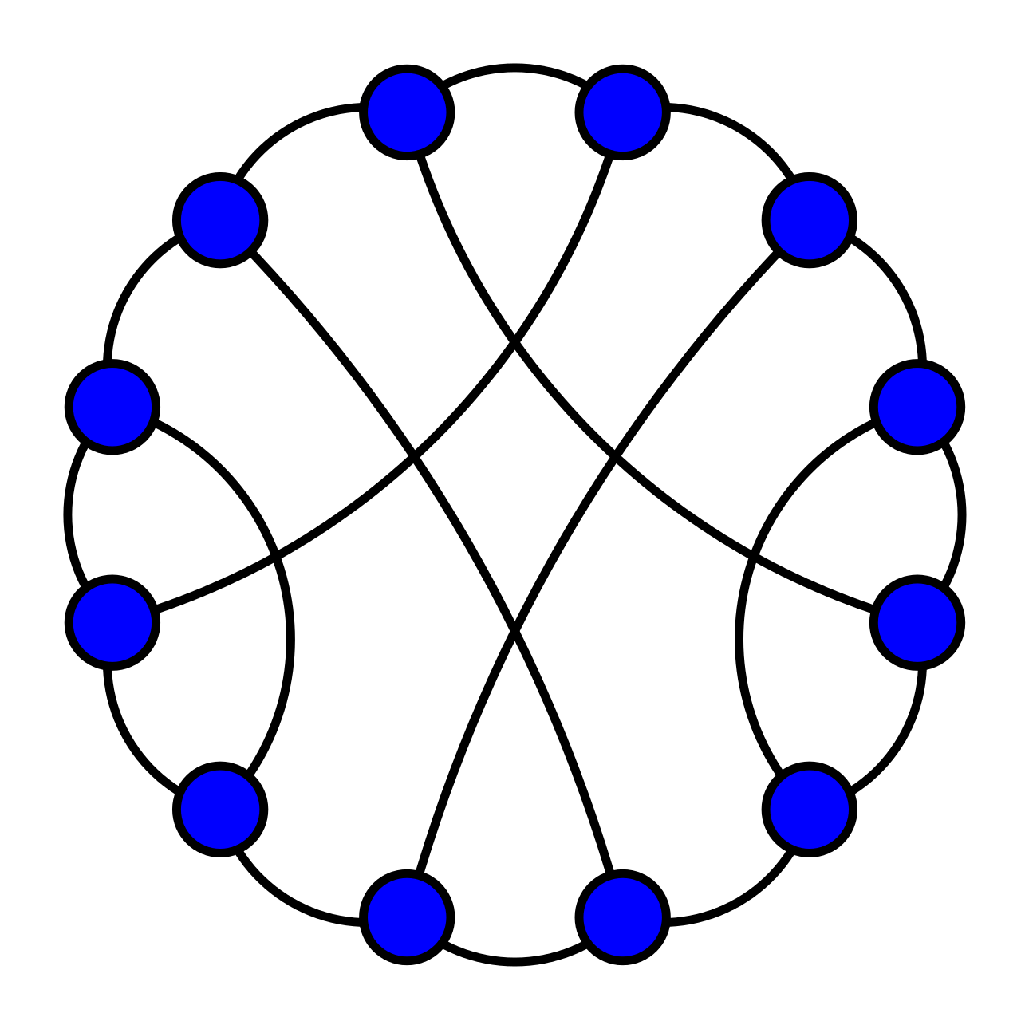
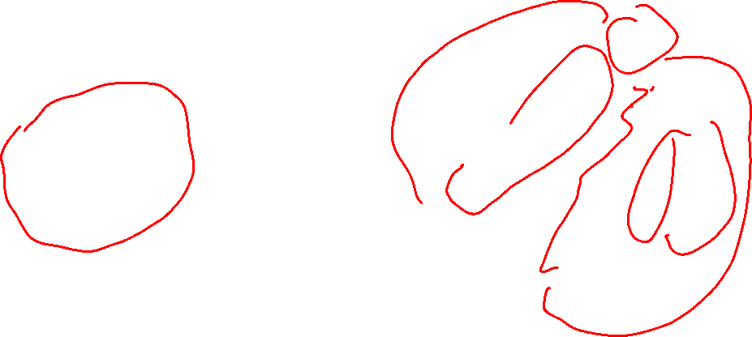
The Durer Graph
All vertices have degree 3, so this is called a 3-regular graph, or cubic graph. It’s also Hamiltonian.
These two graphs are the same, they are just layed-out differently.
See Wikipedia’s list of graphs for more examples.

Slide 37
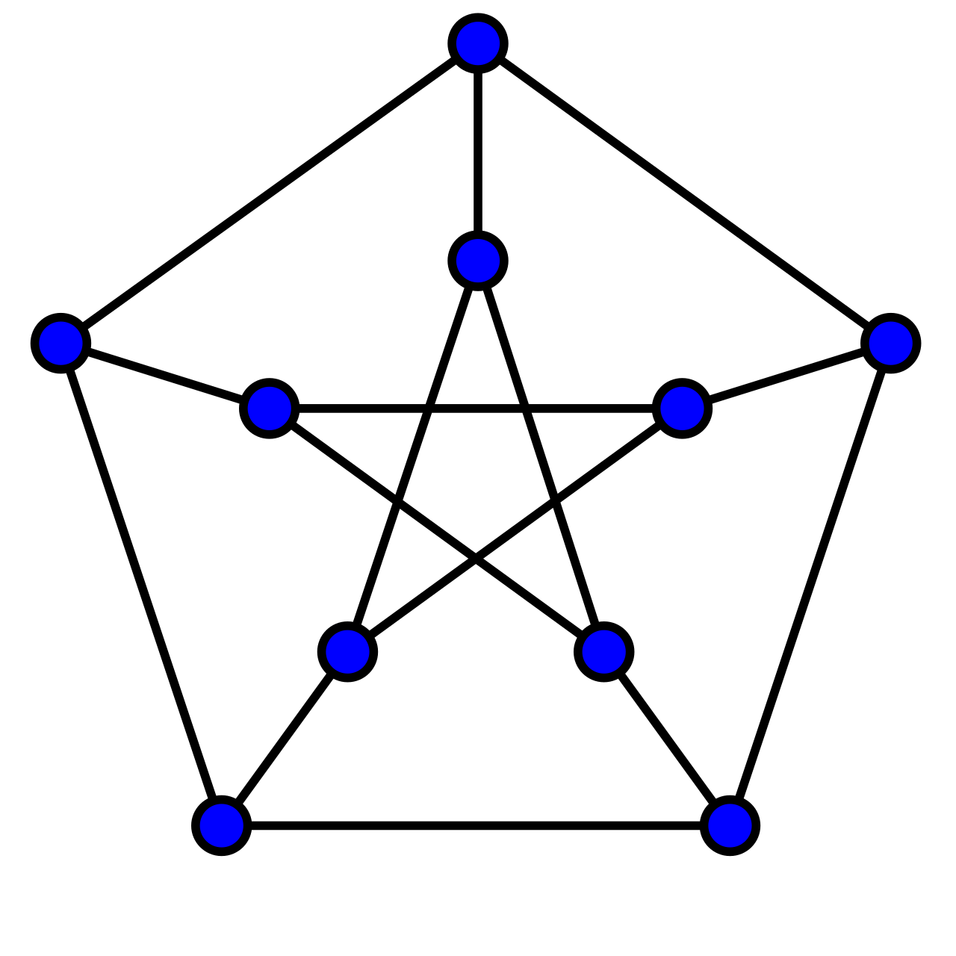
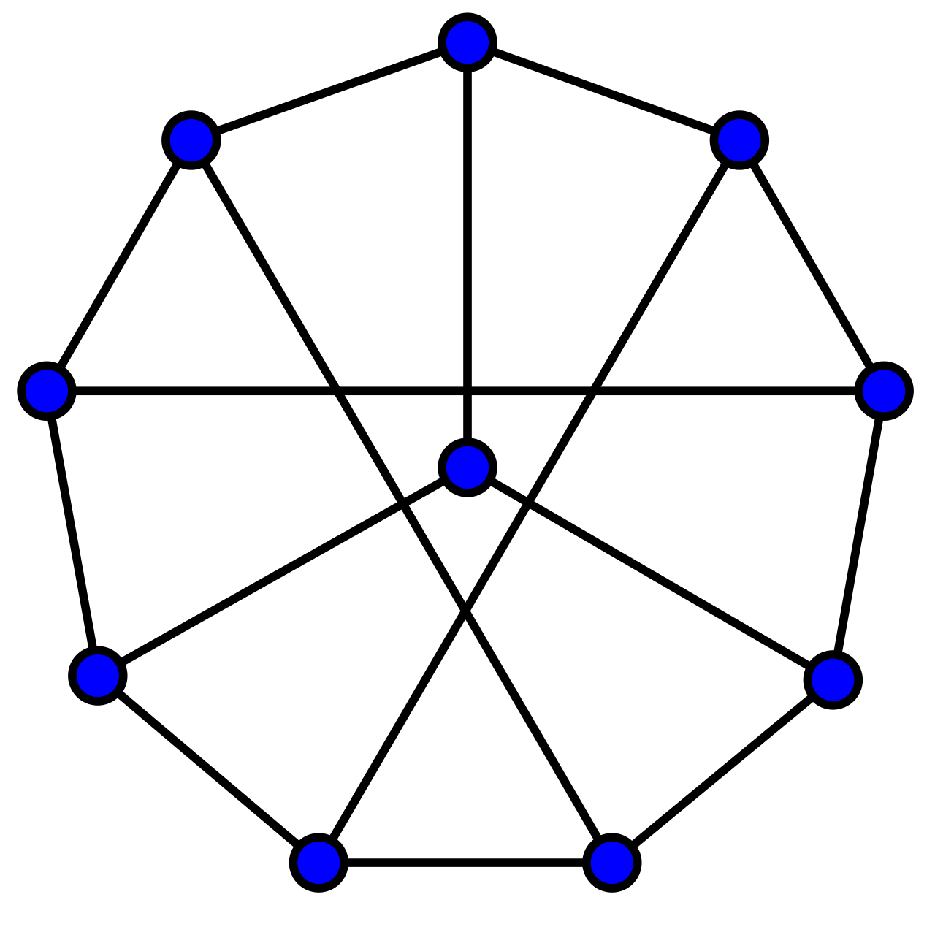
The Petersen Graph
All vertices have degree 3, so this is called a 3-regular graph, or cubic graph.
These two graphs are the same, they are just layed-out differently.
See Wikipedia’s list of graphs for more examples.

Slide 38
Representing Graphs
How could you represent a graph as a data structure in a computer program?
We’ll see two common ways of representing graphs (there are others!)

Slide 39
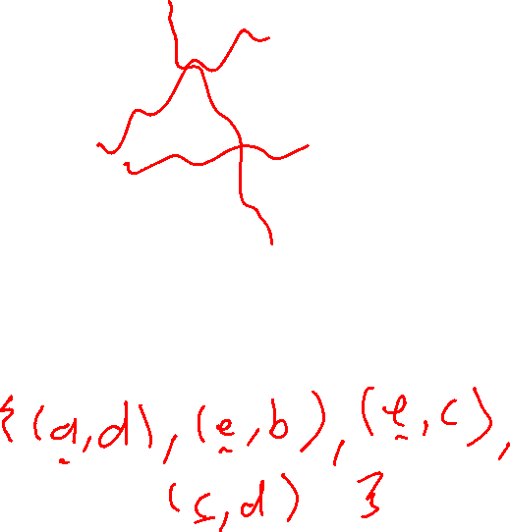
Representing Graphs
a
b
f
Adjacency list The graph is a set of vertex pairs
Adjacency matrix The graph is a 2-dimensional table
c
e
d
V = {a, b, c, d, e, f} E =
E could be a vector of pairs, or a list of pairs, the pairs could be pointers to nodes, etc.

Slide 40
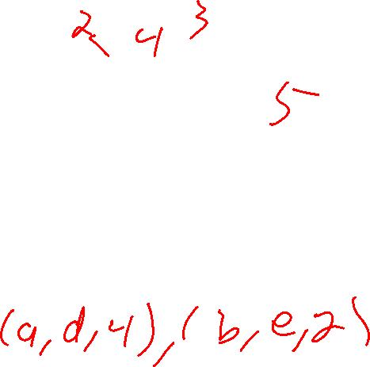
Representing Graphs
a
b
f
Adjacency list The graph is a set of vertex pairs
Adjacency matrix The graph is a 2-dimensional table
c
e
d
V = {a, b, c, d, e, f} E = {(a,d), (b, e), (c,d), (c,e)}
E could be a vector of pairs, or a list of pairs, the pairs could be pointers to nodes, etc.

Slide 41
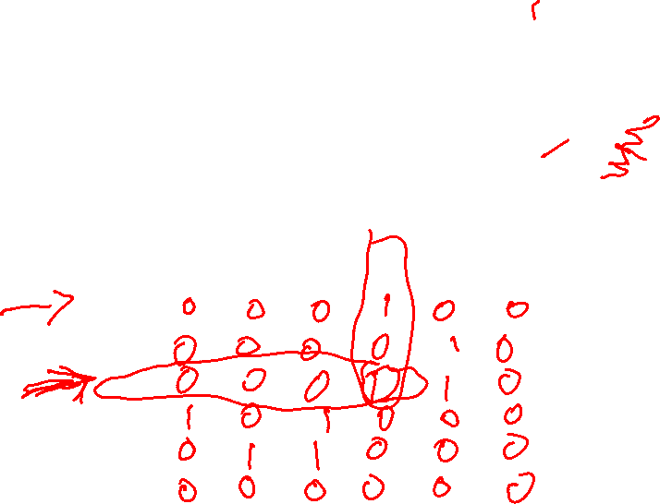
Representing Graphs
a
b
f
Adjacency list The graph is a set of vertex pairs
Adjacency matrix The graph is a 2-dimensional table
c
e
d
 | a | b | c | d | e | f
a
b
c
d
e
f
0 means no edge, 1 means an edge

Slide 42
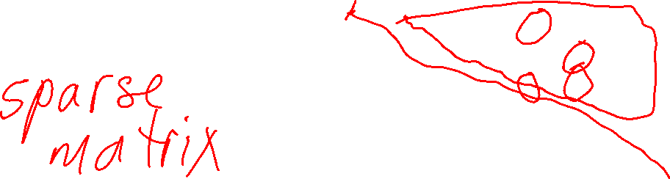
Representing Graphs
a
b
f
Adjacency list The graph is a set of vertex pairs
Adjacency matrix The graph is a 2-dimensional table
c
e
d
 | a | b | c | d | e | f
a | 0 | 0 | 0 | 1 | 0 | 0
b | 0 | 0 | 0 | 0 | 1 | 0
c | 0 | 0 | 0 | 1 | 1 | 0
d | 1 | 0 | 1 | 0 | 0 | 0
e | 0 | 1 | 1 | 0 | 0 | 0
f | 0 | 0 | 0 | 0 | 0 | 0
0 means no edge, 1 means an edge

Slide 43
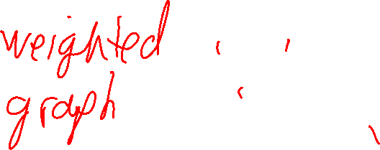
Representing Graphs
a
b
f
Adjacency list The graph is a set of vertex pairs
Adjacency matrix The graph is a 2-dimensional table
c
e
d
For a simple graph, the diagonal is all 0s, because no node has an edge to itself.
 | a | b | c | d | e | f
a | 0 | 0 | 0 | 1 | 0 | 0
b | 0 | 0 | 0 | 0 | 1 | 0
c | 0 | 0 | 0 | 1 | 1 | 0
d | 1 | 0 | 1 | 0 | 0 | 0
e | 0 | 1 | 1 | 0 | 0 | 0
f | 0 | 0 | 0 | 0 | 0 | 0
0 means no edge, 1 means an edge
For an undirected graph, the matrix is also symmetric around the main diagonal.

Slide 44
Representing Graphs
a
b
f
Adjacency list The graph is a set of vertex pairs
Adjacency matrix The graph is a 2-dimensional table
c
e
d
What is the sum of the entries in the adjacency matrix for a simple graph?
 | a | b | c | d | e | f
a | 0 | 0 | 0 | 1 | 0 | 0
b | 0 | 0 | 0 | 0 | 1 | 0
c | 0 | 0 | 0 | 1 | 1 | 0
d | 1 | 0 | 1 | 0 | 0 | 0
e | 0 | 1 | 1 | 0 | 0 | 0
f | 0 | 0 | 0 | 0 | 0 | 0
0 means no edge, 1 means an edge

Slide 45
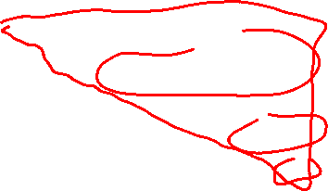
Representing Graphs
a
b
f
Adjacency list The graph is a set of vertex pairs
Adjacency matrix The graph is a 2-dimensional table
c
e
d
What is the sum of the entries in the adjacency matrix for a simple graph?
 | a | b | c | d | e | f
a | 0 | 0 | 0 | 1 | 0 | 0
b | 0 | 0 | 0 | 0 | 1 | 0
c | 0 | 0 | 0 | 1 | 1 | 0
d | 1 | 0 | 1 | 0 | 0 | 0
e | 0 | 1 | 1 | 0 | 0 | 0
f | 0 | 0 | 0 | 0 | 0 | 0
0 means no edge, 1 means an edge
Twice the number of edges. This is another way of thinking about the hand-shaking lemma.

Slide 46
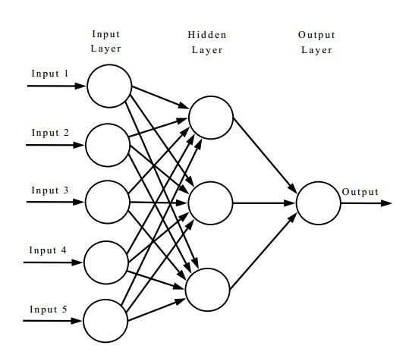
Representing Graphs
Adjacency list The graph is a set of vertex pairs
Adjacency matrix The graph is a 2-dimensional table
Neural networks are typically represented as graphs with lots of weighted edges. Adjacency matrices are often used to represent them.
What are the dimensions of the adjacency matrix that stores this graph?

Slide 47
Representing Graphs
Adjacency list The graph is a set of vertex pairs
Adjacency matrix The graph is a 2-dimensional table
Neural networks are typically represented as graphs with lots of weighted edges. Adjacency matrices are often used to represent them.
What are the dimensions of the adjacency matrix that stores this graph?
9 x 9

Slide 48
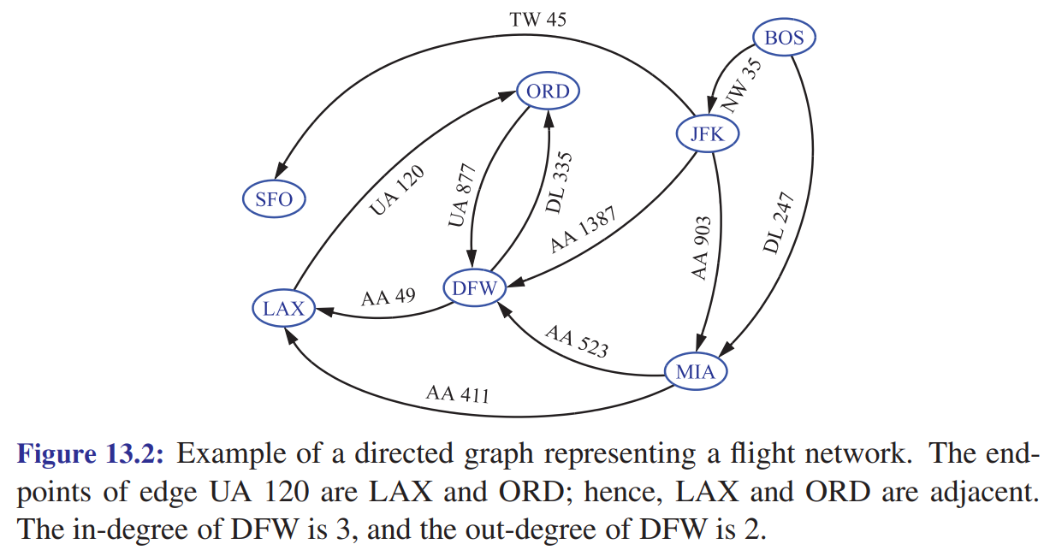

Searching Graphs: Air Travel Maps
Starting at BOS, is it possible to get to LAX? What’s the minimum number of flights?
Vertices are airports, and edges are flights between them.

Slide 49
Searching Graphs: Air Travel Maps
Starting at BOS, is it possible to get to LAX? What’s the minimum number of flights?
Vertices are airports, and edges are flights between them.
Yes! In 2 edges

Slide 50

Searching a Graph
C
B
A
How could we visit the nodes of a graph?
D
E
F
G
H
I

Slide 51

Depth-first Search of a Graph
What order do the nodes get visited when you call Depth-first-search(A)? Trace through the entire call by hand.
Depth-first-search(root)
S = empty stack
visited = {} // hash table
S.push(root)
while not S.empty(): p = S.pop() visit p visited.add(p) for each neighbor n of p: if n not in visited or S:
S.push(n)
A
B
C
D
E
F
G
H
I
Important Check neighbors in alphabetical order (for this example).

Slide 52
Depth-first Search of a Graph
What order do the nodes get visited when you call Depth-first-search(A)? Trace through the entire call.
Depth-first-search(root)
S = empty stack
visited = {} // hash table
S.push(root)
while not S.empty(): p = S.pop() visit p visited.add(p) for each neighbor n of p: if n not in visited or S:
S.push(n)
A
B
C
Depth-first visit order: A, D, G, H, E, F, I, B, C
D
E
F
G
H
I
Important Check neighbors in alphabetical order (for this example).

Slide 53

Visualization of Depth First Search from this article.

Slide 54

Breadth-first Search of a Graph
What order do the nodes get visited when you call Breadth-first-search(A)? Trace through the entire call.
Breadth-first-search(root)
S = empty queue
visited = {} // hash table
S.enqueue(root)
while not S.empty(): p = S.dequeue() visit p visited.add(p) for each neighbor n of p: if n not in visited or S:
S.enqueue(n)
A
B
C
D
E
F
G
H
I
Important Check neighbors in alphabetical order (for this example).

Slide 55

Breadth-first Search of a Graph
What order do the nodes get visited when you call Breadth-first-search(A)? Trace through the entire call.
Breadth-first-search(root)
S = empty queue
visited = {} // hash table
S.enqueue(root)
while not S.empty(): p = S.dequeue() visit p visited.add(p) for each neighbor n of p: if n not in visited or S:
S.enqueue(n)
A
B
C
Breadth-first visit order: A, B, D, E, C, G, F, H, I
D
E
F
G
H
I
Important Check neighbors in alphabetical order (for this example).

Slide 56



Depth-first vs Breadth-first Search
Depth-first Search
Breadth-first Search
$O(v+e)$worst-case performance
Uses a stack
Visits nodes “far” from root first
$O(v)$worst-case memory usage
E.g. when searching a tree, only needs to store nodes along one path from root
$O(v+e)$worst-case performance
Uses a queue
Visits nodes closer to start point
$O(v)$worst-case memory usage
E.g. when searching a tree, will need to store entire level of tree (lots of memory!)
E.g. you could do depth-first search until you find a region of interest, then switch to breadth-first
Many different variations of these search algorithms!
E.g. for some graphs (e.g. trees) you may be able to get rid of the visited list, thus saving memory

Slide 57

Visualization of Breadth First Search from this article.

Slide 58
Depth First Search
Breadth First Search

Slide 59
Shortest paths
What is the adjacency matrix representation of this graph?
3
1
A
B
C
1
1
5
D
6
E
1
F
1
1
1
G
2
H
4
I
The numbers on the edges represent weights, e.g. the cost of moving between the two given nodes.

Slide 60

Shortest paths
What is the adjacency matrix representation of this graph?
3
1
9x9 matrix
A
B
C
 | A | B | C | D | E | F | G | H | I
A | 0 | 3 |  | 1
B |  | 0 | 1
C |  |  | 0 |  |  | 5
D |  |  |  | 0 | 6 |  | 1
E |  | 1 |  |  | 0 |  | 1
F |  |  |  |  |  | 0 |  |  | 1
G |  |  |  |  |  |  | 0 | 2
H |  |  |  |  | 1 |  |  | 0 | 4
I |  |  |  |  |  |  |  |  | 0
1
1
5
D
6
E
1
F
1
1
1
G
2
H
4
I
The numbers on the edges represent weights, e.g. the cost of moving between the two given nodes.
All the empty cells are 0. Since most ($9^{2}−12=69$) entries are 0, this is an example of a sparse matrix.

Slide 61
Shortest paths
start
What is the cost of the path A → B → C → F → I ?
3
1
A
B
C
1
1
5
D
6
E
1
F
1
1
1
G
2
H
4
I
end
The numbers on the edges represent weights, e.g. the cost of moving between the two given nodes.

Slide 62

Shortest paths
start
What is the cost of the path A → B → C → F → I ?
3
1
A
B
C
1
1
5
$$3+1+5+1=10$$
D
6
E
1
F
Is there a shorter path from start to end? If so, what is it, and what is its weight?
1
1
1
G
2
H
4
I
end
The numbers on the edges represent weights, e.g. the cost of moving between the two given nodes.

Slide 63
Shortest paths
start
3
1
A
B
C
1
1
5
A → D → G → H → E → F → I cost: 1 + 1 + 2 + 1 + 1 + 1 = 7
D
6
E
1
F
1
1
1
Can we come up with an algorithm that will find the lowest-cost path between any two nodes of a weighted graph?
G
2
H
4
I
end
The numbers on the edges represent weights, e.g. the cost of moving between the two given nodes.

Slide 64

Dijkstra’s Shortest Path Algorithm
start
3
1
A
B
C
Beginning at a given start node, finds the shortest path from start (and all other nodes in the graph, if you want)
Edge weights must be non-negative
At each node v we will store dist[v], the cost of the lowest-cost path (so far) from start, and a back-pointer to keep track of shortest paths
Dijkstra’s algorithm is a kind of breadth-first search, using a priority queue instead of a regular queue
1
1
5
D
6
E
1
F
1
1
1
G
2
H
4
I
end

Slide 65
Dijkstra’s Algorithm
This version of Dijkstra’s algorithm is based on the one in Wikipedia.
All dist values are initialized to their max possible value.
Algorithm Dijkstra(G, start_node) for each vertex v in G.vertices: dist[v] = +INFINITY prev[v] = nullptr dist[start_node] = 0
PQ = G.vertices
while PQ.size() > 0:
u = vertex in PQ with min dist[u]
remove u from PQ
for each neighbor v of u still in PQ:
alt = dist[u] + G.edge(u, v)
if alt < dist[v]:
dist[v] = alt
prev[v] = u
return dist, prev
PQ is a priority queue, where the key for a vertex is its dist[v] value
dist[v] is the cost of the shortest path from start_node to v
prev[v] is a pointer to the previous node in a shortest path from start_node to v
following prev pointers you can walk from v back to start_node

Slide 66
Dijkstra’s Algorithm
Trace Disjkstra’s algorithm through all nodes on this graph.
Algorithm Dijkstra(G, start_node) for each vertex v in G.vertices: dist[v] = +INFINITY prev[v] = nullptr dist[start_node] = 0
PQ = G.vertices
while PQ.size() > 0:
u = vertex in PQ with min dist[u]
remove u from PQ
for each neighbor v of u still in PQ:
alt = dist[u] + G.edge(u, v)
if alt < dist[v]:
dist[v] = alt
prev[v] = u
return dist, prev
start
3
1
A
B
C
1
1
5
D
6
E
1
F
1
1
1
G
2
H
4
I
end

Slide 67

Solving a Maze with Dijkstra’s Algorithm

Slide 68
Correctness of Dijkstra’s Algorithm
See Proposition 13.23 of the textbook
It’s a proof by contradiction.
Many bookkeeping details! …

Slide 69



Dijkstra’s Algorithm Performance
Values in the priority queue are updated, so for best performance a special priority queue structure must be used
Adaptable priority queue (8.4 of textbook)
(also a Fibonacci heap, see its Wikipedia entry)
On a graph with $v$ vertices and $e$ edges
Adjacency list + adaptable priority queue
$O\left(v\log{v}\right)$ to insert all nodes into priority queue
For each vertex $k$ in the graph:
$O\left(\log{v}\right)$ to remove each node from the priority queue
$O(\deg\left(k\right)⋅\log{v}$) to do the edge “relaxations”
Loop running time: $\sum_{k∈G}{(\log{v}+\deg\left(k\right)⋅\log{v})}$
$$\sum_{k∈G}{(\log{v}+\deg\left(k\right)⋅\log{v})} \\ = \sum_{k∈G}{(1+\deg\left(k\right))\log{v}} \\ = \log{v}\sum_{k∈G}{(1+\deg\left(k\right))} \\ = (log{v})\left(\sum_{k∈G}{1+\sum_{k∈G}{deg⁡(k)}}\right) \\ =(\log{v)}\left(v+2e\right)$$
Running time: $O((v+e)\log{v})$
Since a graph could have $O\left(v^{2}\right)$ edges in the worst-case, running time is also $O(v^{2}\log{v})$
Handshake Lemma sum of degrees of all vertices is twice the number of edges

Slide 70

Dijkstra’s Algorithm vs A* Search
A*-search is a modification of Disjktra’s algorithm that uses a heuristic function to make better choices about which node to visit next. A*-search is often used for path-finding in video games, or searching in symbolic AI.

